Slide 1
School of computing science and Engineering
Course Code : BTCS2401 Course Name: Computer Graphics
Hidden Lines and Surfaces: Back Face Detection algorithm, Depth buffer method
Name of the faculty: Suman Devi

Slide 2
School of computing science and Engineering
Course Code : BTCS2401 Course Name: Computer Graphics
Contents
Back Face Detection:
Theory
Algorithm
Depth Buffer Method:
Theory
Algorithm
Limitations of Depth Buffer
Name of the faculty: Suman Devi Program Name: B.Tech

Slide 3
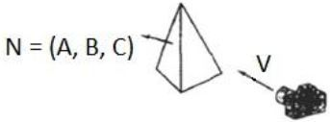
School of computing science and Engineering
Course Code : BTCS2401 Course Name: Computer Graphics
BACK FACE DETECTION
Back face detection algorithm works on ‘solid’ objects which we are looking at from the outside. That is, the polygons of the surface of the object completely enclose the object.
The simplest thing we can do is find the faces of polyhedral and discard them.
Name of the faculty: Suman Devi Program Name: B.Tech

Slide 4
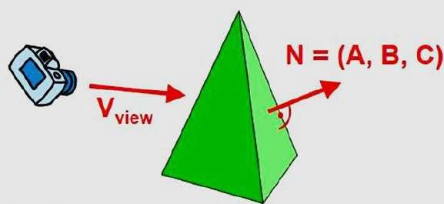
School of computing science and Engineering
Course Code : BTCS2401 Course Name: Computer Graphics
BACK FACE DETECTION
A fast and simple object-space method for identifying the back faces of a polyhedron is based on the "inside-outside" tests. A point (x, y, z) is "inside" a polygon surface with plane parameters A, B, C, and D if When an inside point is along the line of sight to the surface, the polygon must be a back face .
We can simplify this test by considering the normal vector N to a polygon surface, which has Cartesian components (A, B, C).
Name of the faculty: Suman Devi Program Name: B.Tech

Slide 5
School of computing science and Engineering
Course Code : BTCS2401 Course Name: Computer Graphics
ALGORITHM
In general, if V is a vector in the viewing direction from the eye (or "camera") position, then this polygon is a back face if
V.N > 0
Name of the faculty: Suman Devi Program Name: B.Tech

Slide 6
School of computing science and Engineering
Course Code : BTCS2401 Course Name: Computer Graphics
ALGORITHM
The conditions for a face to be backface or frontface are:
1. Front Face - V.N < 0
2. Back Face - V.N > 0
Name of the faculty: Suman Devi Program Name: B.Tech

Slide 7
School of computing science and Engineering
Course Code : BTCS2401 Course Name: Computer Graphics
ALGORITHM
Furthermore, if object descriptions are converted to projection coordinates and your viewing direction is parallel to the viewing z-axis, then −
The normal contains N(A,B,C) but whereas the Vx, Vy components of the viewing angle will be 0 as the viewing angle in parallel to Z – axis.
So the V becomes = (0,0,Vz) and the N = (A,B,C)
V.N becomes = Vz.C
For it to be backface Vz.C>0.
Name of the faculty: Suman Devi Program Name: B.Tech

Slide 8
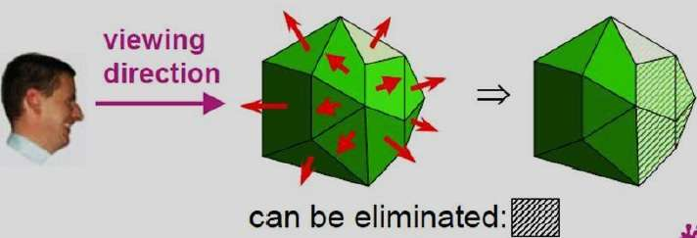
School of computing science and Engineering
Course Code : BTCS2401 Course Name: Computer Graphics
ALGORITHM
Therefore in right Handed system with viewing direction along the negative Zv axis, the polygon is a back face if C<0. Also, we cannot see any face whose normal has z component C=0, since our viewing direction is towards that polygon. Thus, in general, we can label any polygon as a back face if the normal vector has a z component value:
C <= 0
Name of the faculty: Suman Devi Program Name: B.Tech

Slide 9
School of computing science and Engineering
Course Code : BTCS2401 Course Name: Computer Graphics
Depth Buffer Method
Depth buffer algorithm is simplest image space algorithm. For each pixel on the display screen, we keep a record of the depth of an object within the pixel that lies closest to the observer. In addition to depth, we also record the intensity that should be displayed to show the object. Depth buffer is an extension of the frame buffer. Depth buffer algorithm requires 2 arrays, intensity and depth each of which is indexed by pixel coordinates (x, y).
Name of the faculty: Suman Devi Program Name: B.Tech

Slide 10
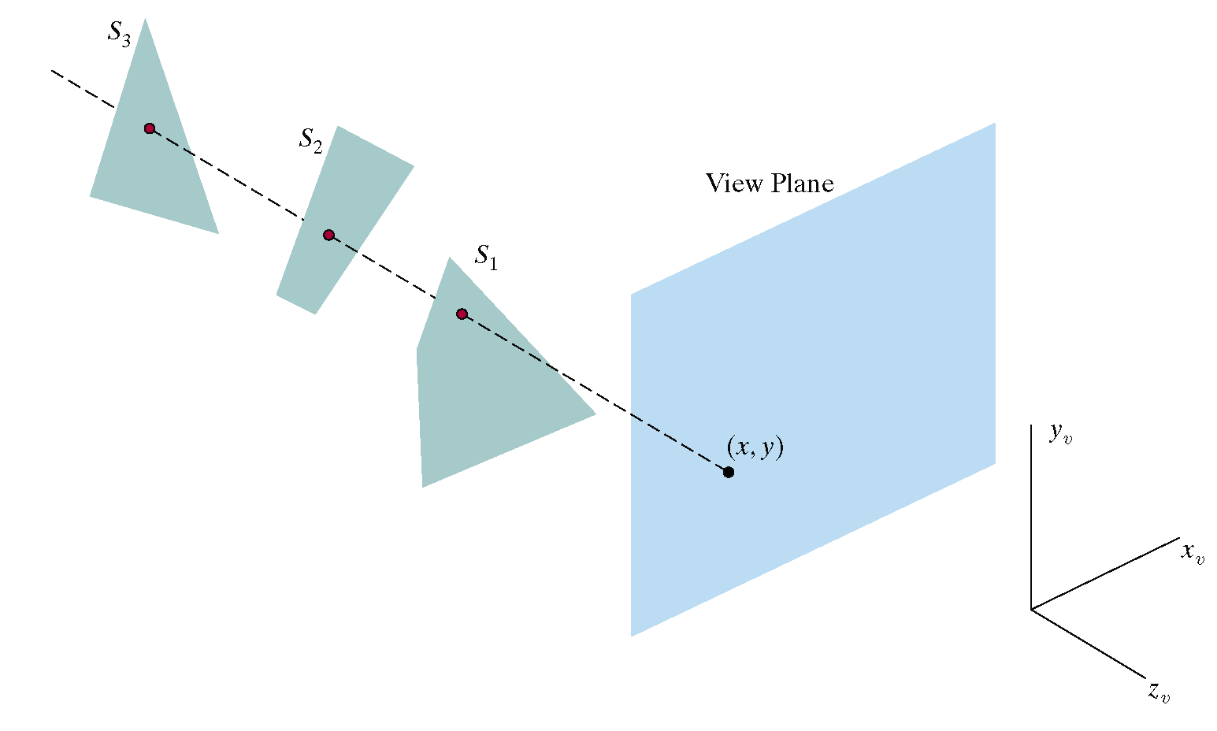
School of computing science and Engineering
Course Code : BTCS2401 Course Name: Computer Graphics
Depth Buffer Method
Name of the faculty: Suman Devi Program Name: B.Tech

Slide 11
School of computing science and Engineering
Course Code : BTCS2401 Course Name: Computer Graphics
Algorithm
For all pixels on the screen, set depth [x, y] to 1.0 and intensity [x, y] to a background value.
For each polygon in the scene, find all pixels (x, y) that lie within the boundaries of a polygon when projected onto the screen. For each of these pixels:
Calculate the depth z of the polygon at (x, y)
If z < depth [x, y], this polygon is closer to the observer than others already recorded for this pixel. In this case, set depth [x, y] to z and intensity [x, y] to a value corresponding to polygon's shading. If instead z > depth [x, y], the polygon already recorded at (x, y) lies closer to the observer than does this new polygon, and no action is taken.
Name of the faculty: Suman Devi Program Name: B.Tech

Slide 12
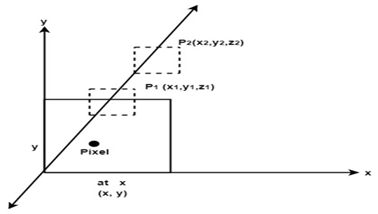
School of computing science and Engineering
Course Code : BTCS2401 Course Name: Computer Graphics
Algorithm
After all, polygons have been processed; the intensity array will contain the solution.
The depth buffer algorithm illustrates several features common to all hidden surface algorithms.
Name of the faculty: Suman Devi Program Name: B.Tech

Slide 13
School of computing science and Engineering
Course Code : BTCS2401 Course Name: Computer Graphics
Algorithm
First, it requires a representation of all opaque surface in scene polygon in this case.
These polygons may be faces of polyhedral recorded in the model of scene or may simply represent thin opaque 'sheets' in the scene.
The 2nd important feature of the algorithm is its use of a screen coordinate system. Before step 1, all polygons in the scene are transformed into a screen coordinate system using matrix multiplication.
Name of the faculty: Suman Devi Program Name: B.Tech

Slide 14
School of computing science and Engineering
Course Code : BTCS2401 Course Name: Computer Graphics
Limitations of Depth Buffer
The depth buffer Algorithm is not always practical because of the enormous size of depth and intensity arrays.
Generating an image with a raster of 500 x 500 pixels requires 2, 50,000 storage locations for each array.
Even though the frame buffer may provide memory for intensity array, the depth array remains large.
Name of the faculty: Suman Devi Program Name: B.Tech

Slide 15
School of computing science and Engineering
Course Code : BTCS2401 Course Name: Computer Graphics
Limitations of Depth Buffer
To reduce the amount of storage required, the image can be divided into many smaller images, and the depth buffer algorithm is applied to each in turn.
For example, the original 500 x 500 faster can be divided into 100 rasters each 50 x 50 pixels.
Processing each small raster requires array of only 2500 elements, but execution time grows because each polygon is processed many times.
Name of the faculty: Suman Devi Program Name: B.Tech

Slide 16
School of computing science and Engineering
Course Code : BTCS2401 Course Name: Computer Graphics
Limitations of Depth Buffer
Subdivision of the screen does not always increase execution time instead it can help reduce the work required to generate the image. This reduction arises because of coherence between small regions of the screen.
Name of the faculty: Suman Devi Program Name: B.Tech

Slide 17
School of Computing Science and Engineering
Course Code : BTCS2401 Course Name: Computer Graphics
Reference :
1 . Donald Hearn and M Pauline Baker, “Computer Graphics C Version”, Pearson Education, India; 2 edition 2002.
2. Computer Graphics Principles and Practice, Second Edition in C, James D.Foley, Andries Van Dam, Steven K.Feiner, JhonF.Hughes, Addison Wesley, Third Edition, 2014.
3. Steven Harrington, “Computer Graphics: A Programming Approach” , McGraw-Hill Inc.,US; 2nd Revised edition, 1983.
4. David Rogers, “Procedural Elements of Computer Graphics”, McGraw Hill Education; 2 edition, 2017.
Name of the Faculty: Suman Devi Program Name: B.Tech

Slide 18
School of Computing Science and Engineering
Course Code : BTCS2401 Course Name: Computer Graphics
Thank you!
Name of the Faculty: Suman Devi Program Name: B.Tech

